Slide 1
Credible Sources for Research
Lisa K. Gailey
Mesita Elementary Librarian

Slide 2
Credible
It is important that students look for relevant sources of information. Research maybe a tiring process but when it comes to credibility, it is a must.
Don’t know how to find credible sources, you are in the right place!

Slide 3
Credible Sources: Definition
Credible sources are ones that can be considered unbiased and some sort of evidence to rely on.

Slide 4
Credible Sources
Are published within the last ten years.
Are written by respected
Belong to educational and governmental institutions
Articles from Google Scholar
Academic databases (EPISD databases in Classlink such as TexQuest, EBSCO, TexGuide)
Famous online dictionaries and encyclopedias.

Slide 5
Non-Credible Sources
Non-credible sources are the complete opposite of the Credible Source’s definition. They should not be used especially when you are working on essential pieces of writing. An unreliable source would most definitely be outdated and coming from the writers with no credentials. Blog posts are a caution as they don’t have any citations.

Slide 6
Non-Credible Sources
Outdated information
Texts written by someone without proper credentials
Articles without citations
Blog posts

Slide 7
How to Determine Credible Sources
Pay close attention to several things when you look for credible sources.
All information should be current or published within the last few years usually within the last three to five years.
Check the authors to make sure they are well known and have received acknowledgement.
Websites belonging to governmental or educational institutions are reliable.

Slide 8
Why Is It Important to Use Credible Sources for Research?
No one will believe the arguments you make if it is based on Wikipedia information.
Trustworthy sources guarantees that your statements will convenience the readers.
An academic research paper is expected to be backed up by reliable evidence.
Often unreliable sources may contain errors or mistakes.

Slide 9
Web Domains in Scholarly Research
Where does your source come from?
Government or Military (.gov or .mil) are generally credible sources on the web.
University (.edu) check for credibility and authority.
Company websites (.com) be aware that company websites are used to promote so make sure the information in non-biased.
Special Interest (.org) while many professional organizations end in .org there are also many.orgs that are biased and promote a specific agenda.

Slide 10
Evaluating Web Sites

Slide 11
Strategies
Check the facts: there are many fact checking websites available online. A good fact checking service will use neutral wording and will provide unbiased, authoritative sources to support their claims.
Check the “About Us” section. Does it disclose a source of funding? You will know the purpose and viewpoint.
Citations and Evidence: Information is cited so you can track down the source and verify it. What evidence is used to prove the author’s point?Is the information used logically.

Slide 12
Beware of:
Websites that contain the suffix “lo” or end in “.com.co"
Websites that urge you to dox an individual or organization
Websites that have amateurish design, use all caps, and play on your emotions.
Memes making the rounds of Facebook or other social media sites.
Clickbait or sensationalist headlines and odd photos.

Slide 13
Burst your filter bubble
Web browsers and social media sites employ algorithms that feed you information you’ve show a preference for. The filter bubble connects us to news that ends to reinforce our set views, rather than challenging us with new ideas.
Seek credible information from both sides of an issue.
Use databases that aren’t influenced by your previous web searches
Talk to people with a different view from yours.

Slide 14
Examples of Credible Sources:Websites
JSTOR - online library of books, articles, and journals.
GoogleScholar - easy to use search engine of scholarly pieces of writing and free to use.
SAGE Publishing - independent publisher gives open-access to academic journals, subscription based.
Taylor and Francis Online - publish peer-reviewed journal articles. Free admission is limited.
Academia - free resource similar to GoogleScholar.
Scopus - one of the biggest peer-reviewed journals and articles.

Slide 15
List of Credible News Sources
BBC News - one of the most trusted sources you can ever find. They post fresh pieces of news in text, video, or audio format.
The Economist- well known and respected weekly magazine with a focus on international business, economics, and politics. Available online.
The Wall Street Journal - business journal and published digitally and broadsheet format.
Google News - Set your preferences and it generates an endless stream of articles based on interest.
The Guardian - A British newspaper that has been in business for over 200 years. Online publications are free.
CNN - international TV channel which covers business and politics.

Slide 16
Credible Sources on Natural Science
NASA - a governmental source of information about the most recent discoveries and explorations of space. Live streams of launching and landing.
Scientific American - subscription based on science and technology.
Popular Science - Won multiple awards for its science-oriented source for the general audience.
National Geographic - Nature lovers source of exciting news and documentaries on most topics.

Slide 17
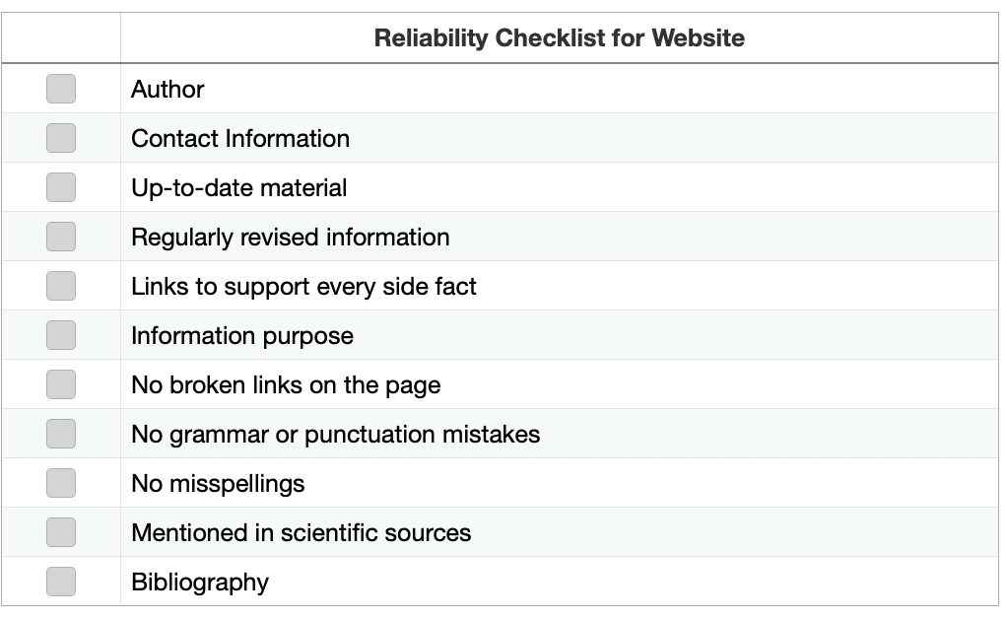
Website Reliability Checklist
Look for at least 9 of these signs in your article

Slide 18
References
University of Maryland Global Campus, 2022, Evaluating Web Sites [video] https://youtu.be/kzWS0t5F-wE

